Slide 1
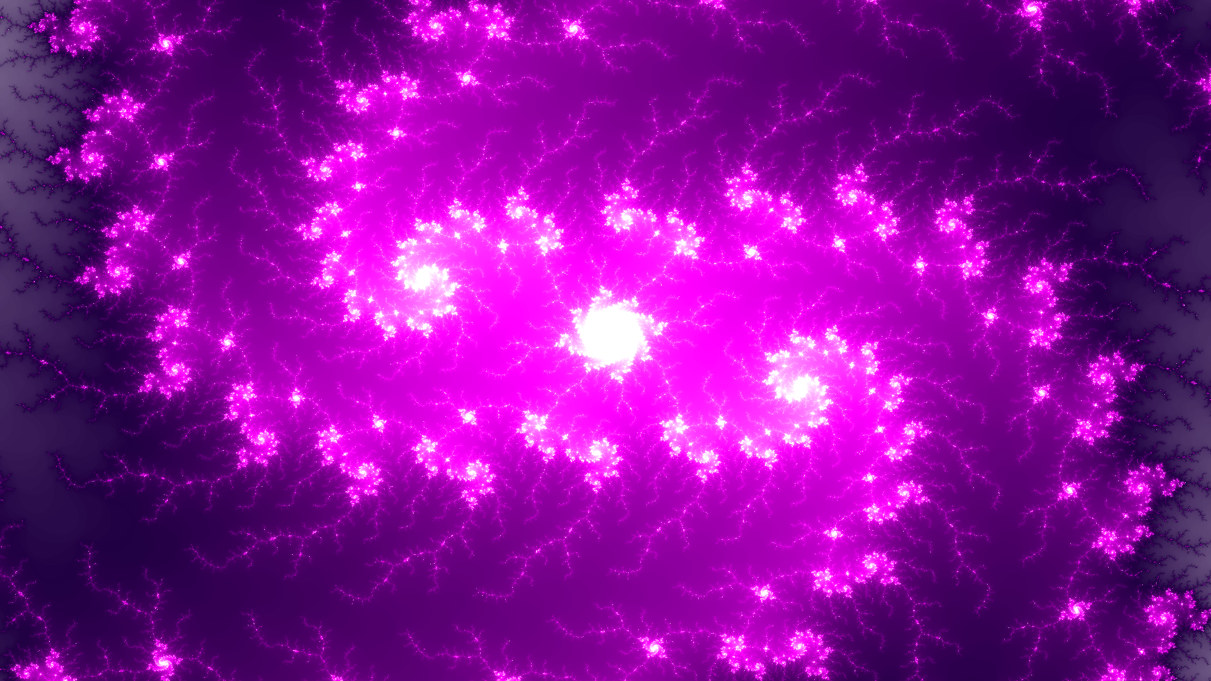
Rendering Fractals Using the PYNQ Framework on an FPGA
Filip Lejhanec

Slide 2
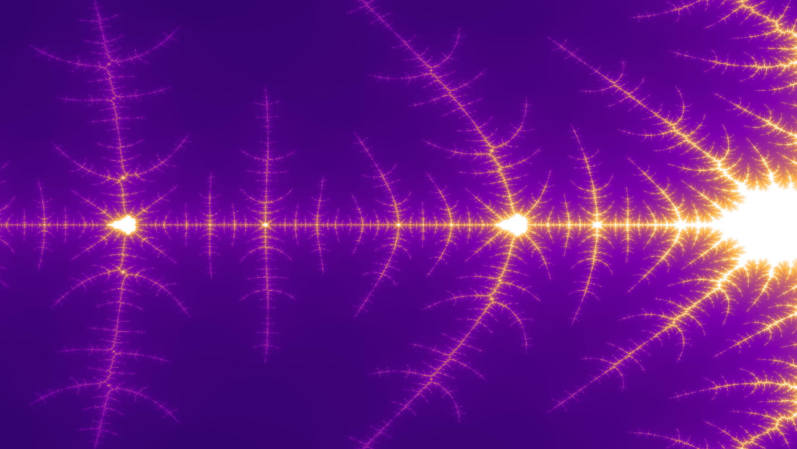
Key objectives
Problem research
Software implementation
Hardware implementation
Stretch goals
Advanced visual features (zooming, panning and colouring)
Implementation issues and optimising for speed
Flexible and reusable design

Slide 3
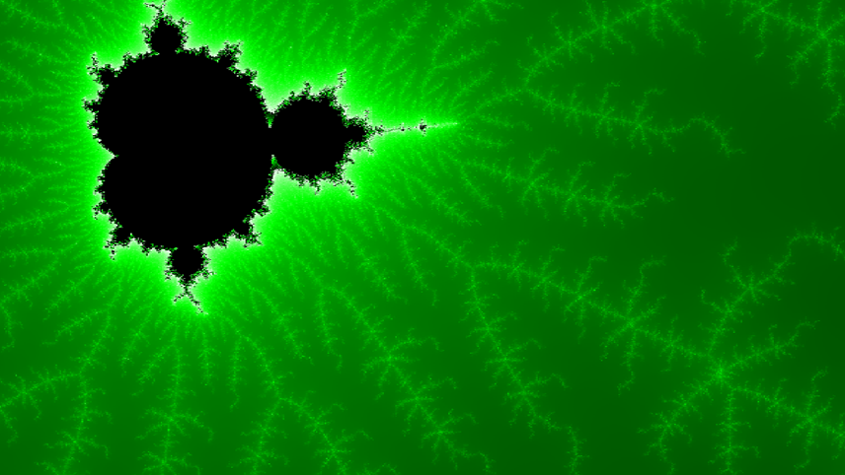


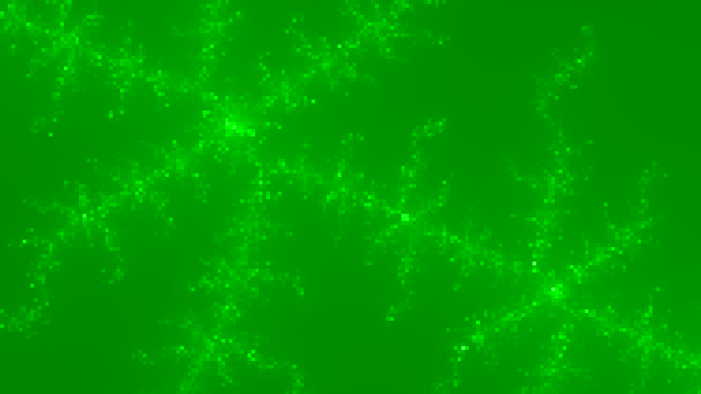
Implementation details
Floating point vs. Fixed point
32-bit variables
Full HD output to HDMI
1 frame/second
16 parallel processors
Customisable
Friendly drivers

Slide 4
Render Times of Different IP Implementations

Slide 5
PC Monitor
HDMI Monitor
PyQt GUI
SSH Shell
PYNQ-Z1
GPU Renderer
FPGA Circuit

Slide 6
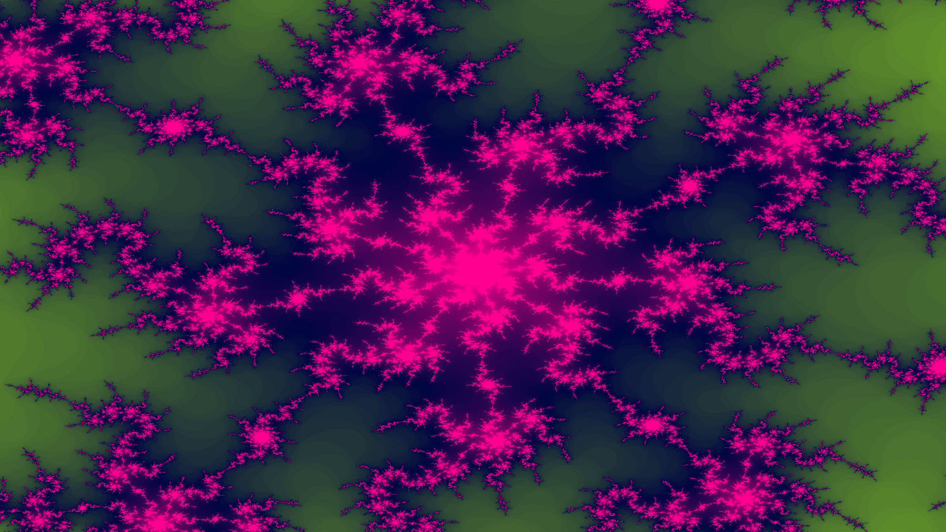

Slide 7
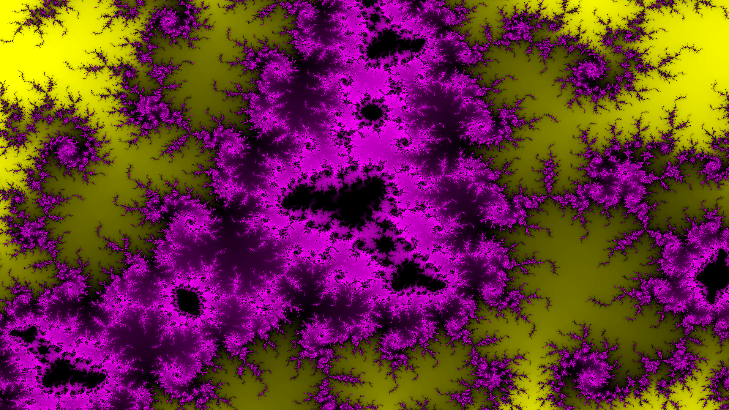

Slide 8
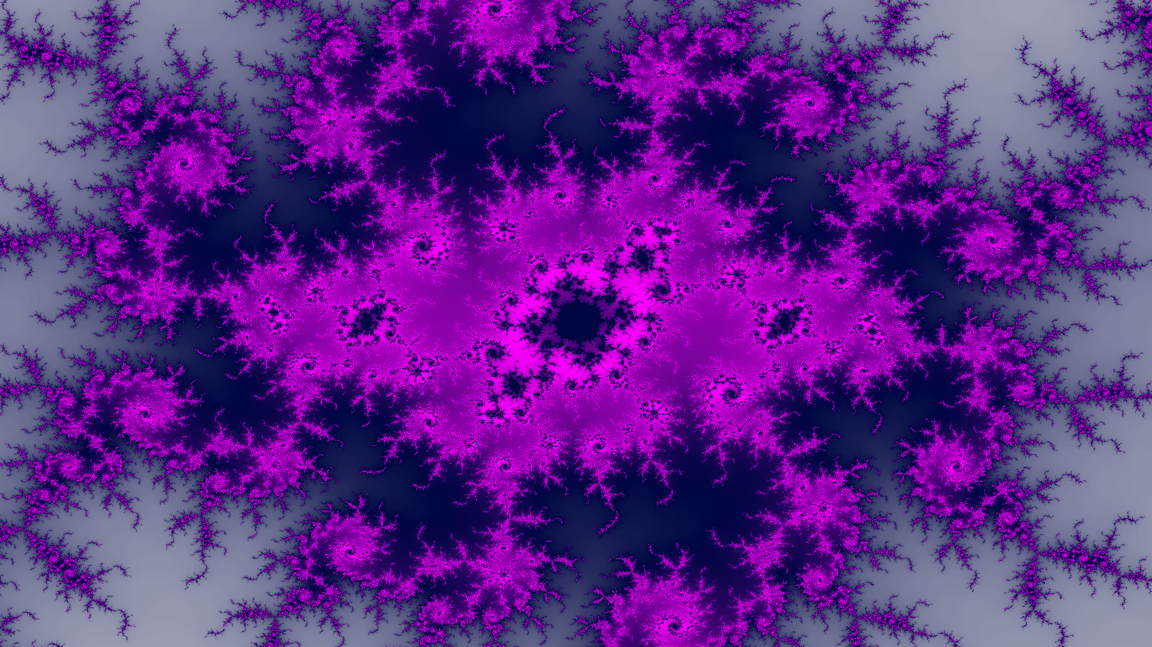

Slide 9
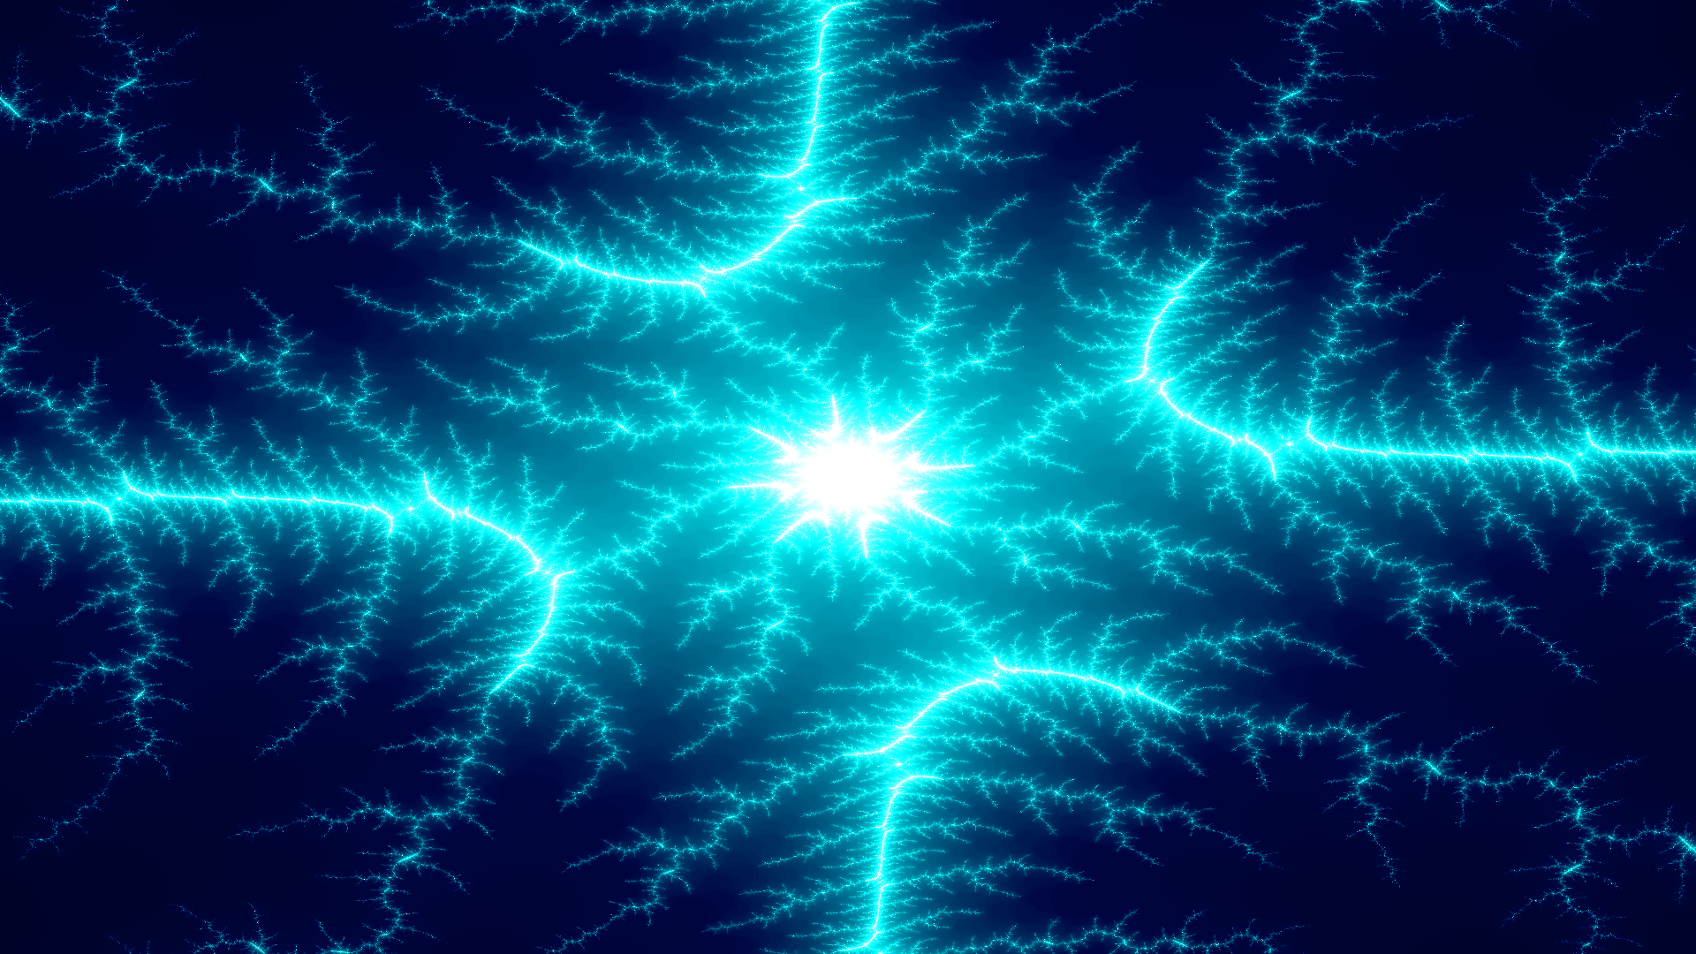

Slide 10
